Slide 1
Team Larfleeze
Final Project
By:
Nathan Graham
Matt Wilhelm
Brandon Fowler

Slide 2
Basics:
“Dungeon and dragons” theme
Dungeon crawler
Programmed in Java language
Command Line Based(No GUI)

Slide 3
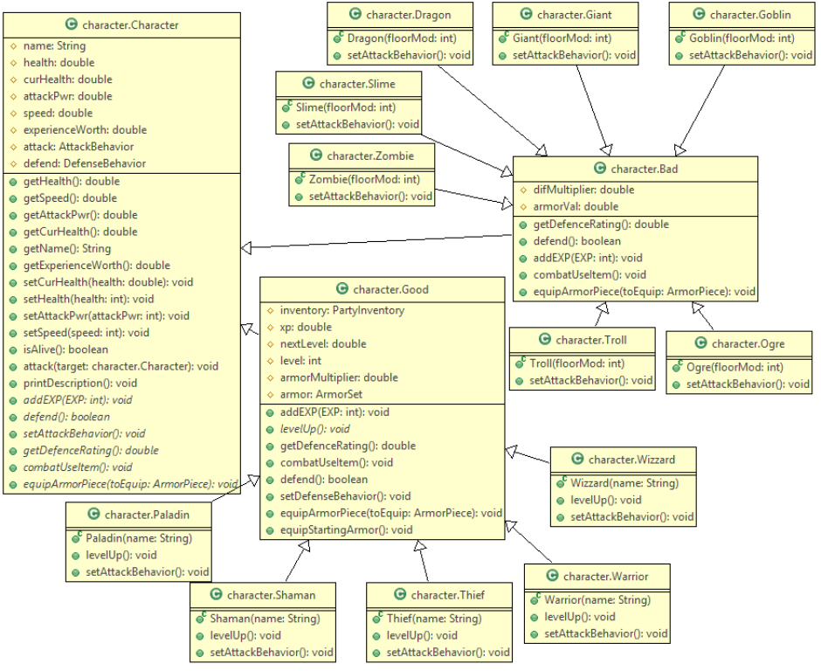
UML Diagrams
Character Hierarchy

Slide 4
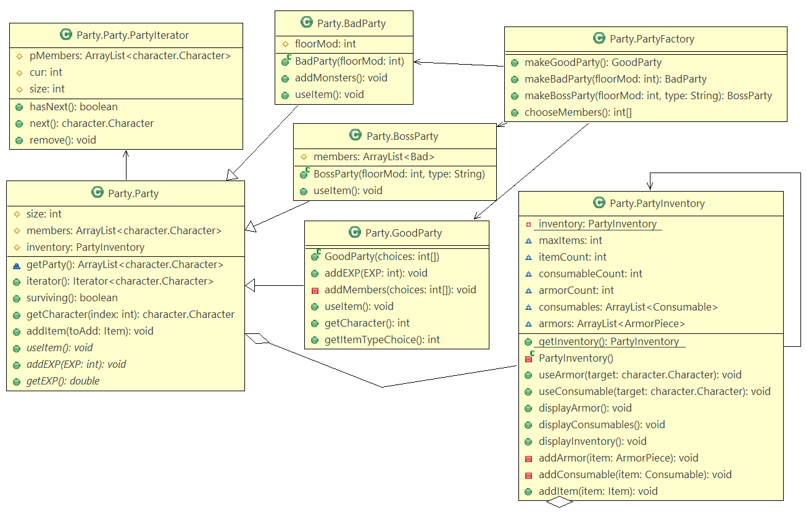
UML Diagrams
Party System

Slide 5
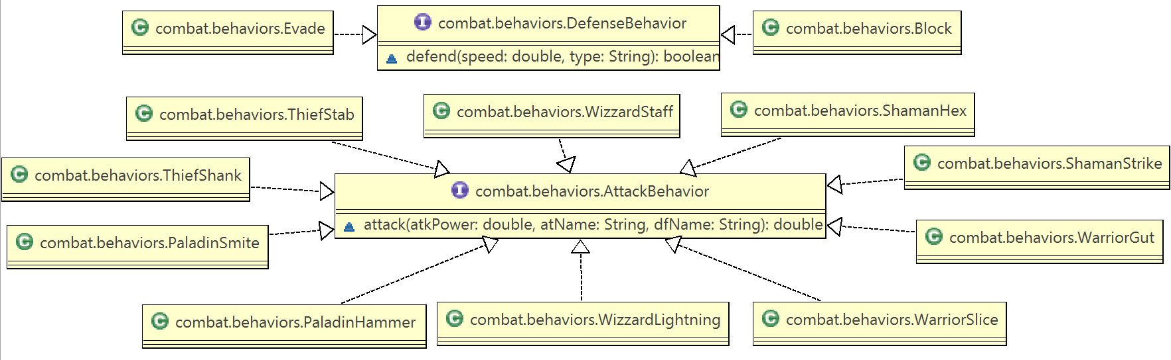
UML Diagrams
Hero Attack Behaviors

Slide 6
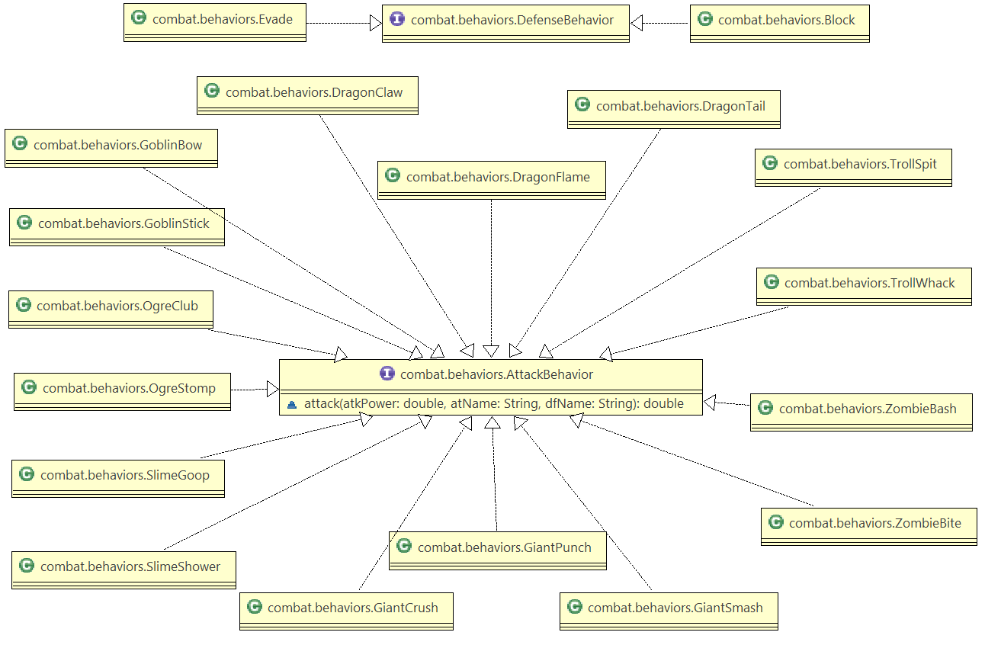
UML Diagrams
Monster Attack Behaviors

Slide 7
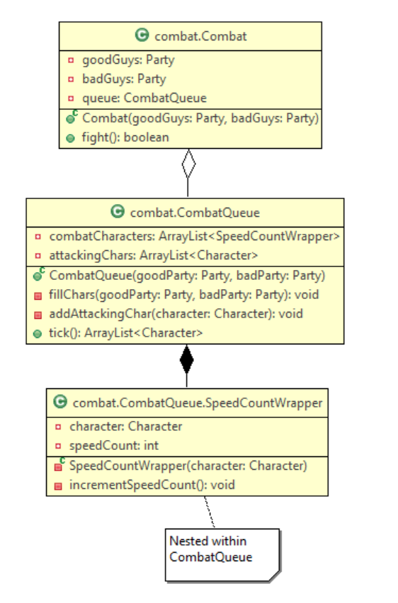
UML Diagrams
Combat System

Slide 8
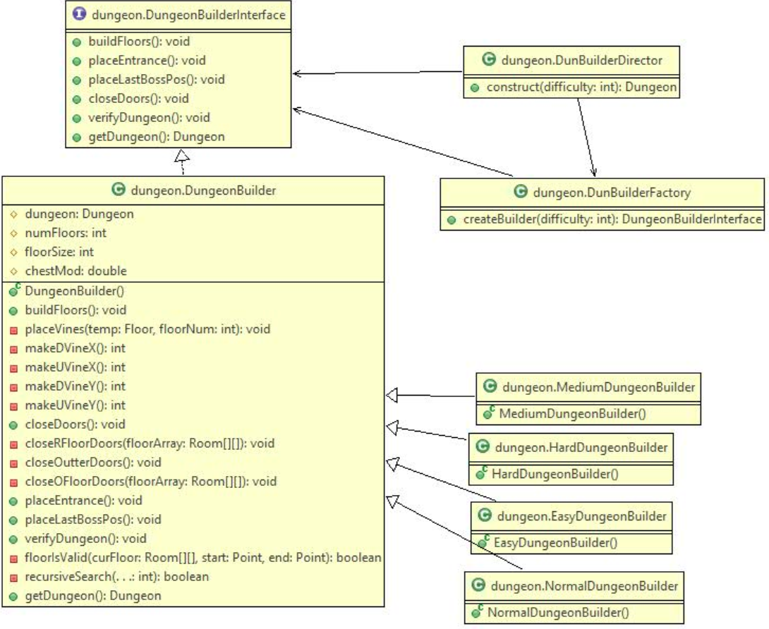
UML Diagrams
Dungeon Builder

Slide 9
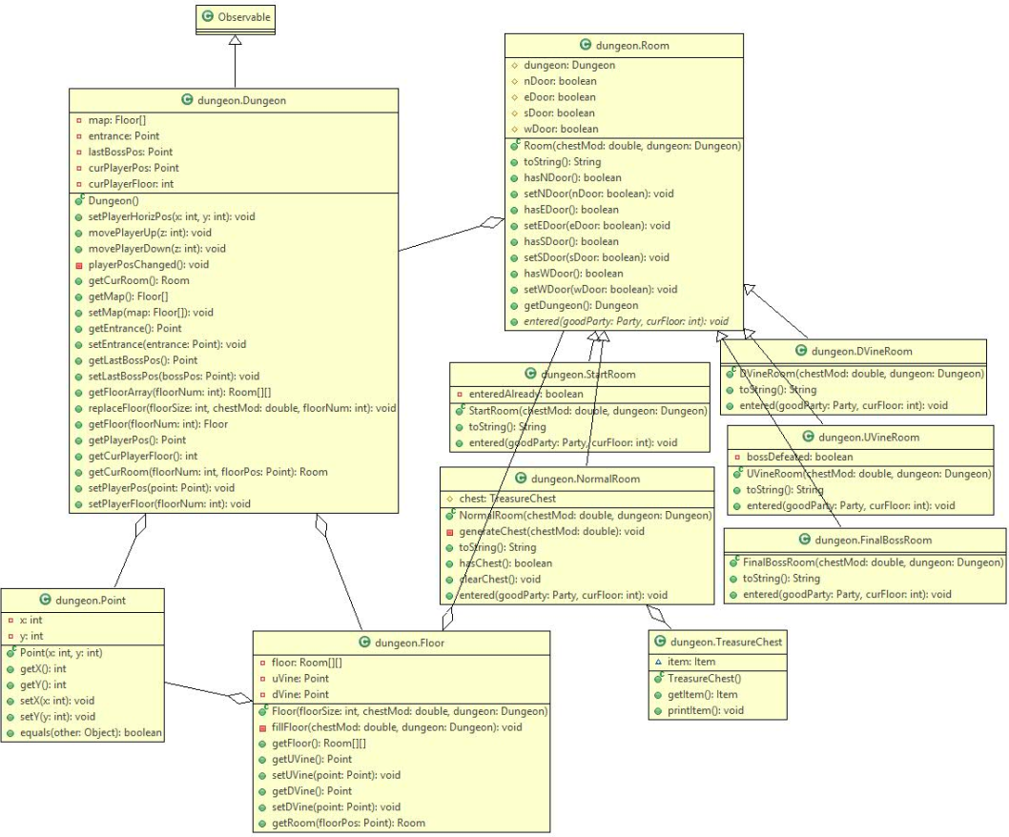
UML Diagrams
Dungeon Structure

Slide 10
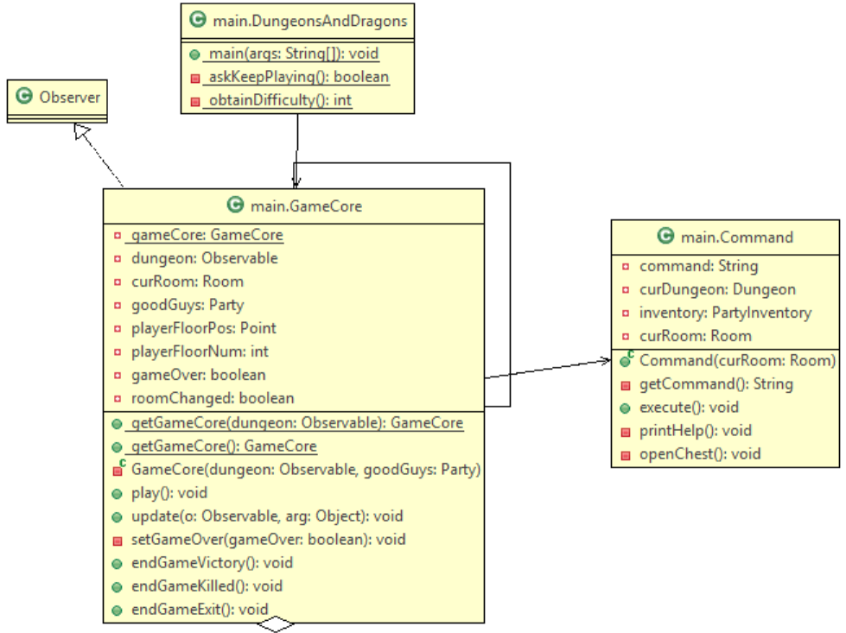
UML Diagrams
Main

